Slide 1

HEBREWS 10:23
Pastor Rod M. Lago

Slide 2
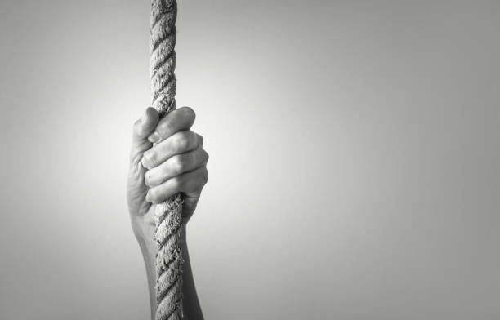
What do we mean by Holding Fast?

Slide 3
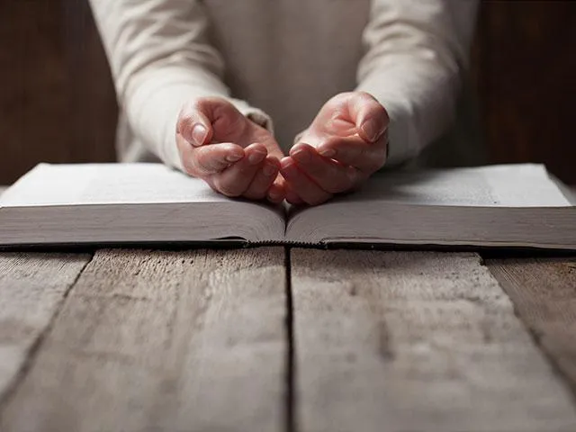
I. Holding Fast means Trusting God Wholeheartedly.

Slide 4
How can we Trust God?
Remember Who God is. – He is Omnipotent (All-Powerful), Omniscient (All Knowing), Omnipresent (He is Everywhere)
Remember what God can do. – He specializes in turning a bad situation for our good.
Allow God to work through you. – God is Working in your life even in the darkest and bleakest moment of your life.

Slide 5
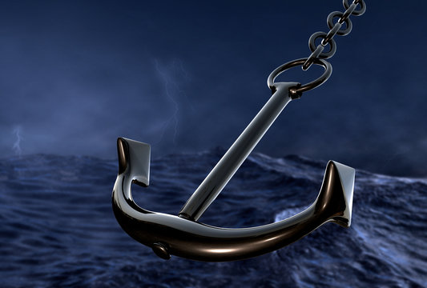
II. Holding Fast means being Anchored in Hope.

Slide 6
Why do we need to Hold on to our Hope?
HOPE gives us Courage in the midst of Adversities.
1 Peter 1:6-7, James 1:2
HOPE drives you to God for Answers. – Romans 5:5
HOPE prepares our life for His Return. – 1 John 3:2-3

Slide 7
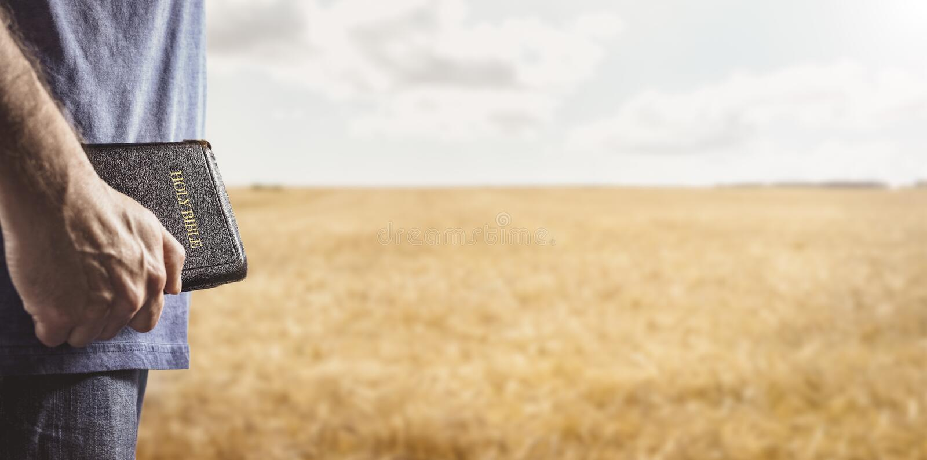
III. Holding Fast means Staying in His Word.

Slide 8

Staying in His Word means:
Keep your Mind on what is Right.
Fixing your heart to godly things.
Connected to Him as a branch is connected to its vine.

